Slide 1

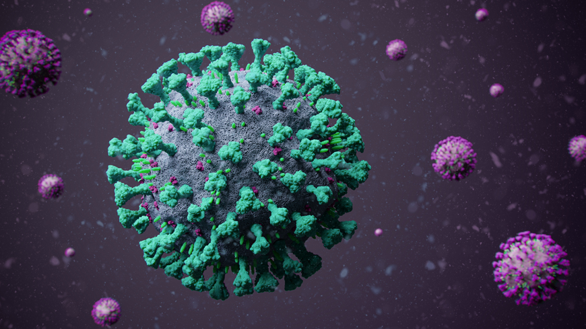
7/2021
Data Science Project
19-COVID
How the vaccine has affected the corona virus
By Shiran Yosef and Idan Toledano

Slide 2


Some background
On late December 2019, a new coronavirus was identified in China, causing severe respiratory disease including pneumonia. It was originally named Novel Coronavirus by the World Health Organization (WHO), and later has been renamed as severe acute respiratory syndrome coronavirus 2.
The symptoms include: fever, fatigue, a loss or change of sense of smell or taste, and dry cough. These indicate an early stage of the illness. some patients may progress to severe illness.

Slide 3
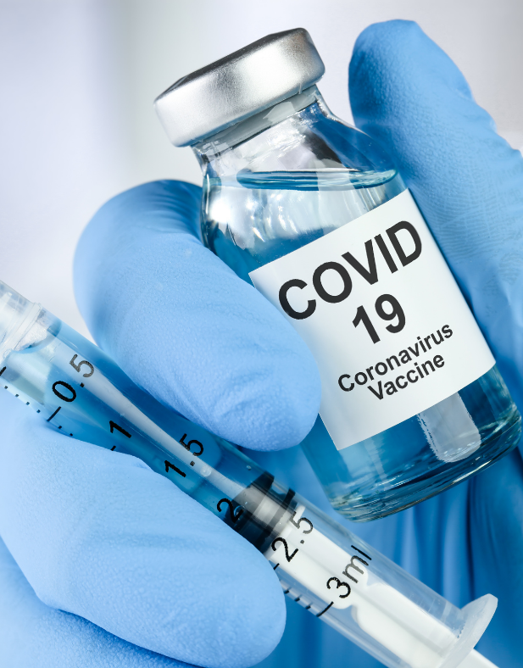
Coronavirus Vaccine
COVID-19 vaccines are safe and effective.
COVID-19 vaccination is a critical prevention measure to help end the COVID-19 pandemic.
COVID-19 vaccines are now widely accessible in the United States.
COVID-19 vaccine is given from the age of 12 and up.
Three COVID-19 vaccines are currently authorized by the U.S. Food and Drug Administration (FDA) for emergency use: two mRNA vaccines (Pfizer-BioNTech, Moderna) and one viral vector vaccine (Johnson & Johnson/Janssen vaccine). People are considered fully vaccinated if they are ≥2 weeks following receipt of the second dose in a 2-dose series, or ≥2 weeks following receipt of a single-dose vaccine.

Slide 4
Work Plan
Data exploration
let the data talk
Models for machine learning
Guided learning and regression
Conclusions
Checking the results
Data
acquisition
Arranging the data

Slide 5
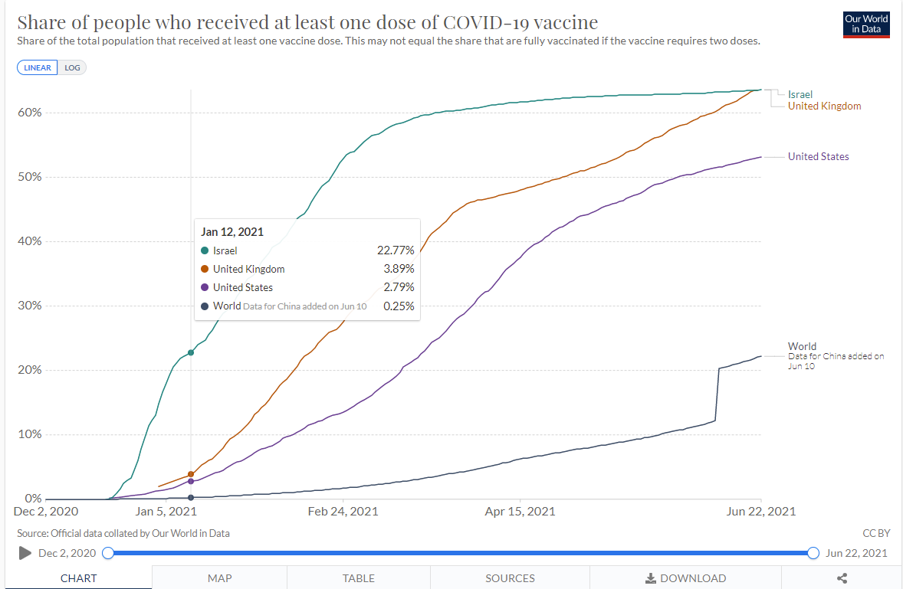

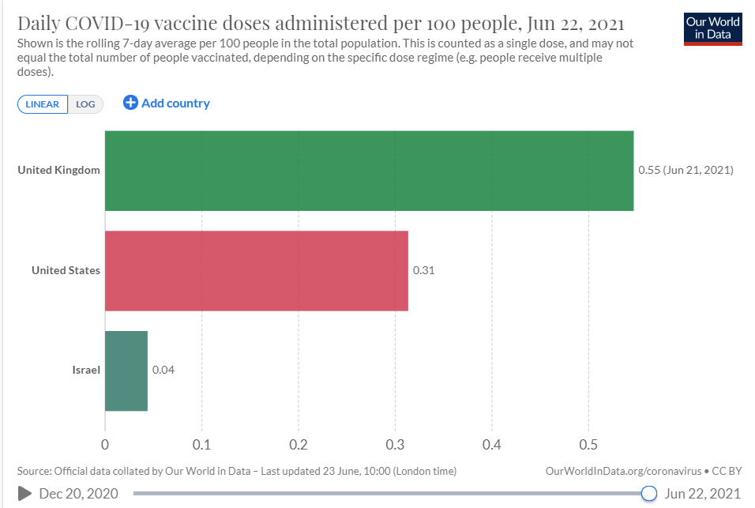
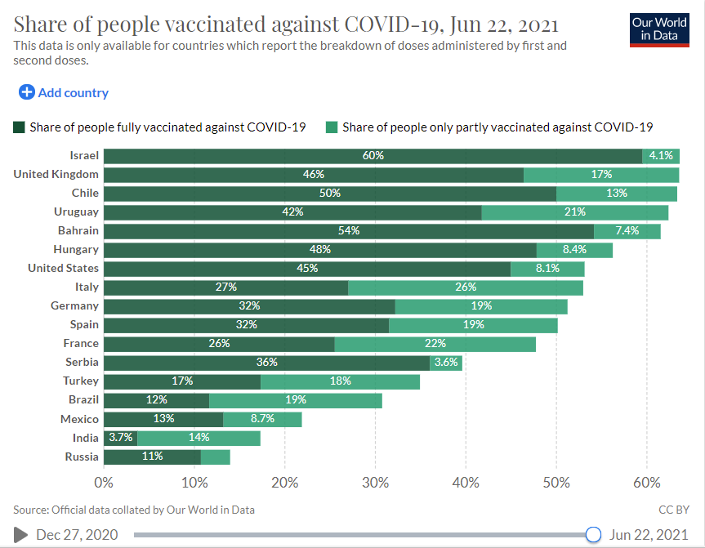
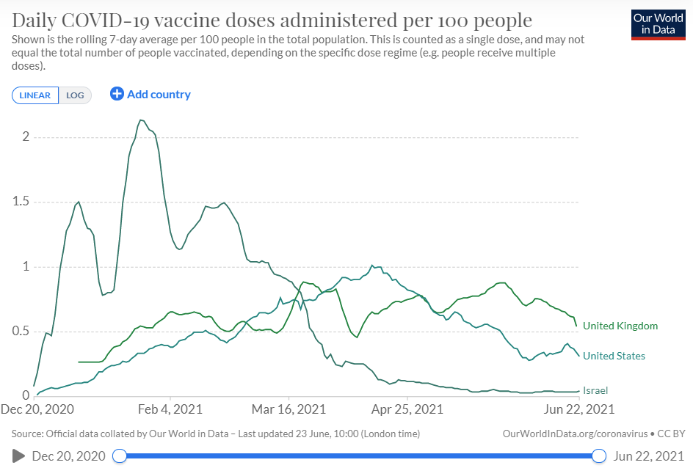

Slide 6
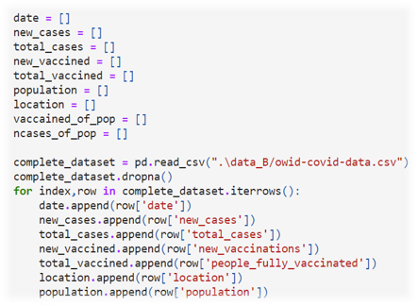
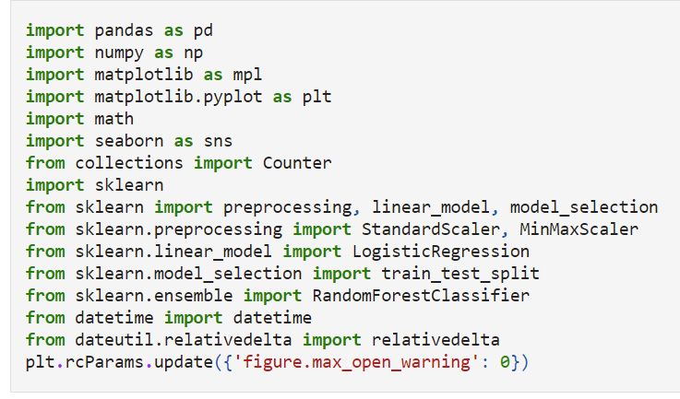
Imported necessary libraries and extract relevant Data columns

Slide 7

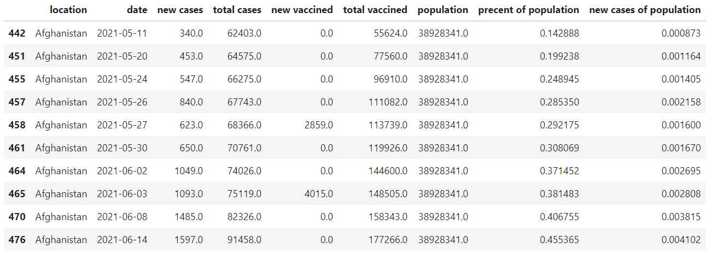
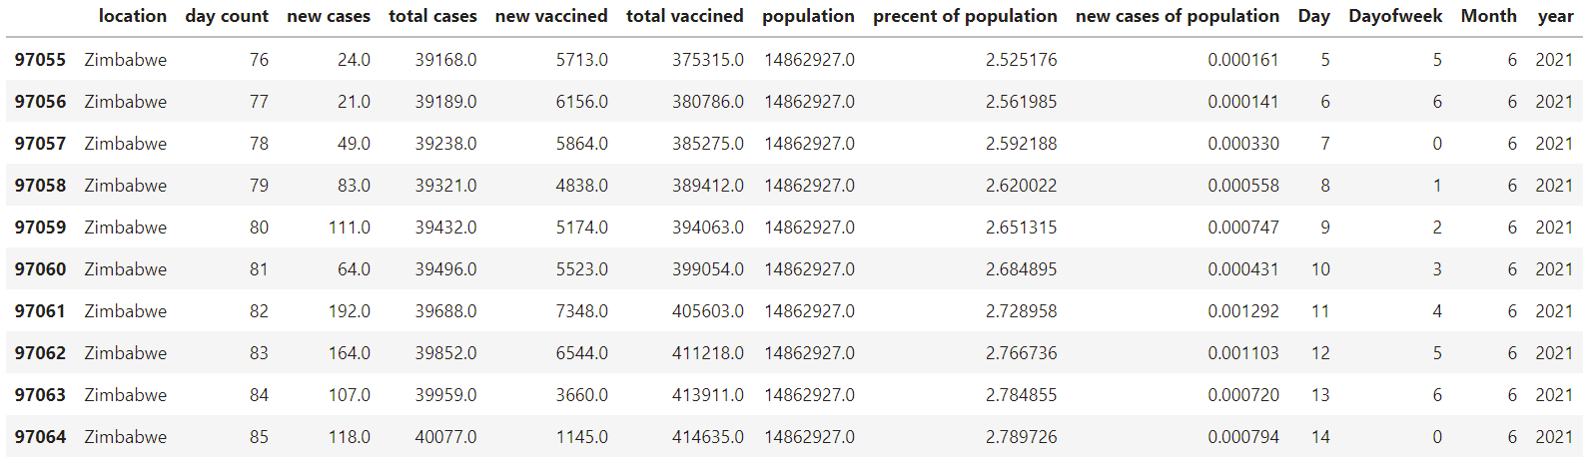
Dataset handling and splitting to pre vaccine and after vaccine

Slide 8

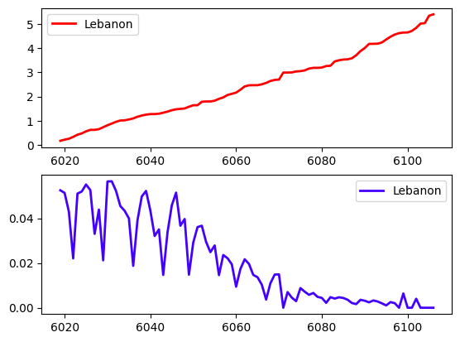
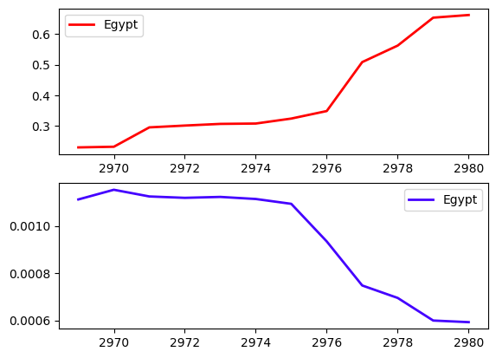
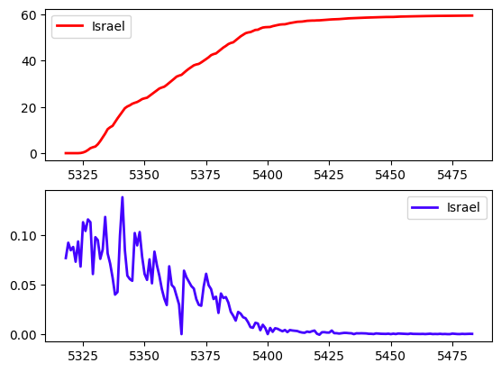
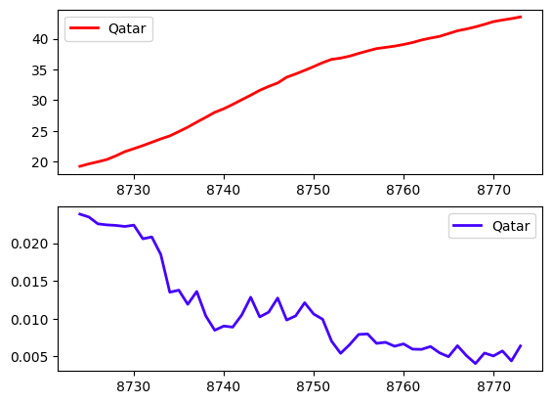
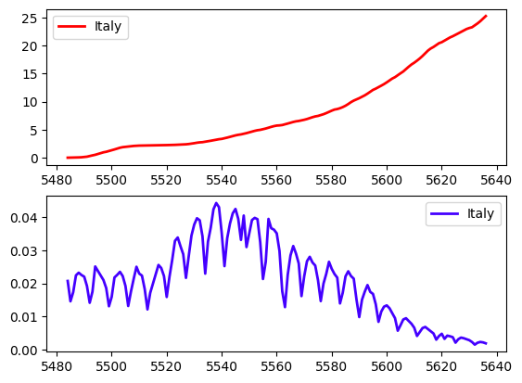
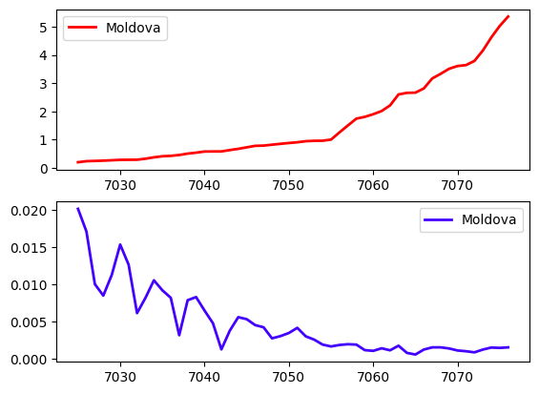
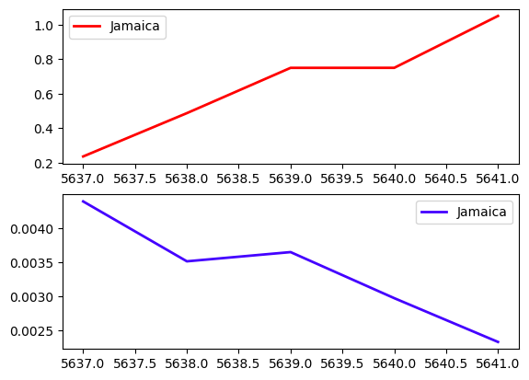
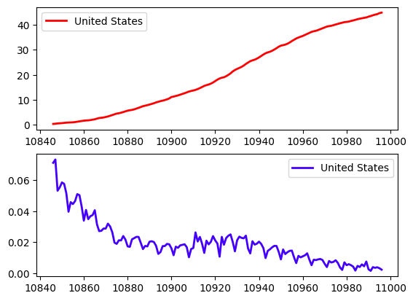
These graphs show the development of countries after vaccination. You can see the total of vaccinated and infected people. Most of the time, we have found that as much as there are more vaccinated people, there are fewer patients.

Slide 9
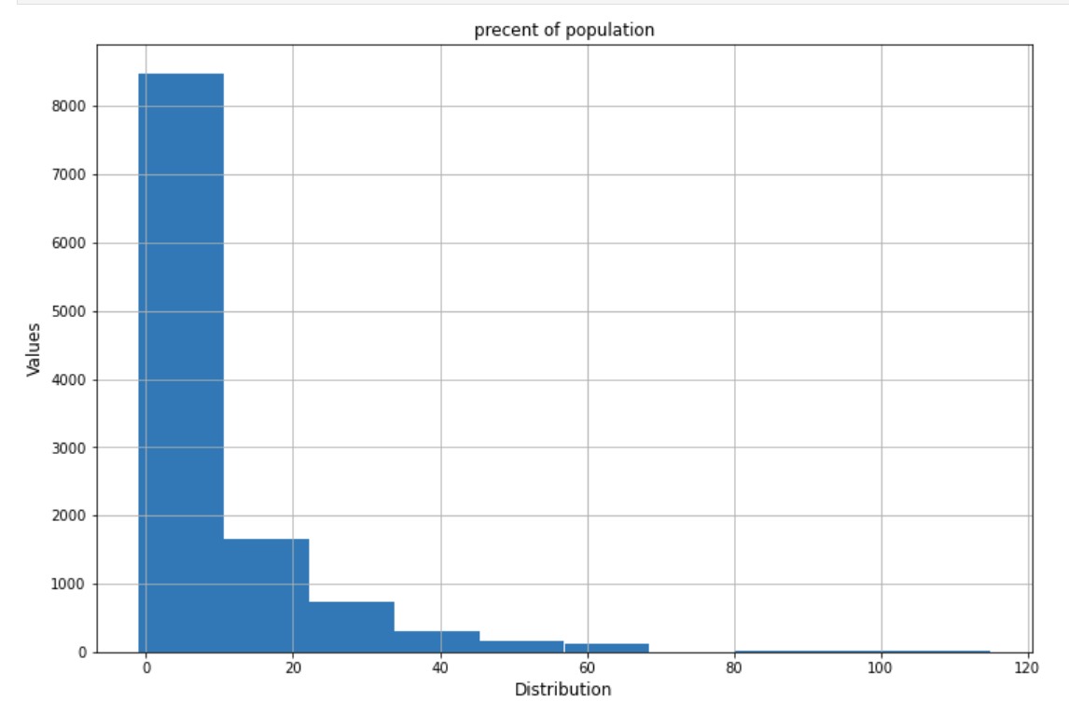
Machine Learning Part
The histogram of 'percent of population' column to see the distribution

Slide 10
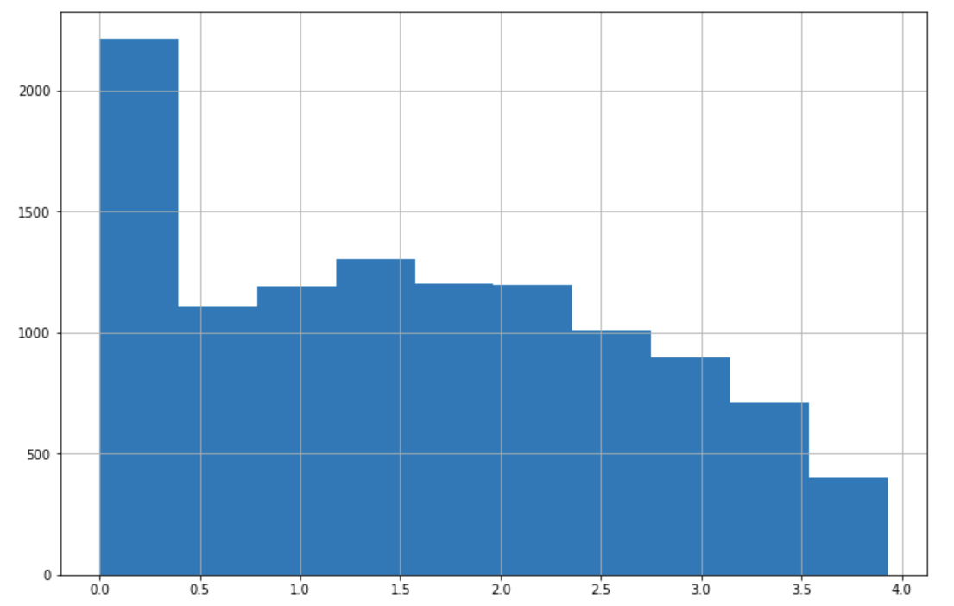
Machine Learning Part
Take log of 'percent of population' column to make the histogram standard

Slide 11
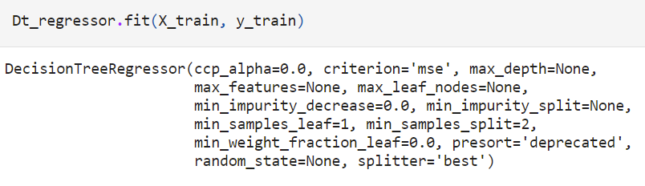
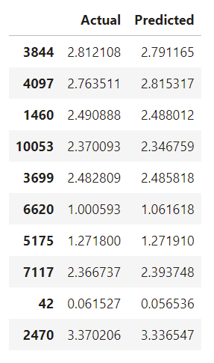
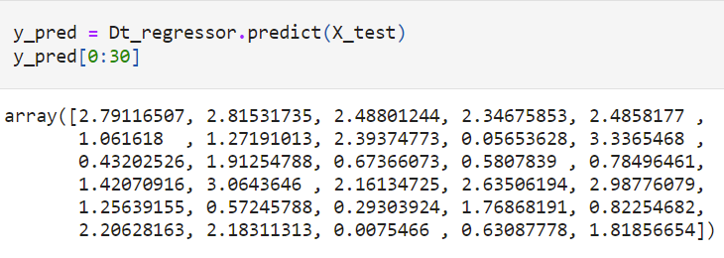
Decision Tree Regression Model:
Make predictions using DecisionTreeRegressor and display the first 30 predicted values
Compare the Actual Vs Predictd Values in the Test Set

Slide 12
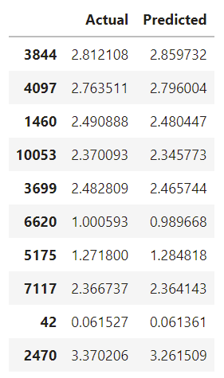
Random Regression Model

Slide 13

Conclusion
Both performed well on this data set, but Random seems performing a little better than Decision Tree in terms of evaluation metrics for predicting 'precent of population'

Slide 14
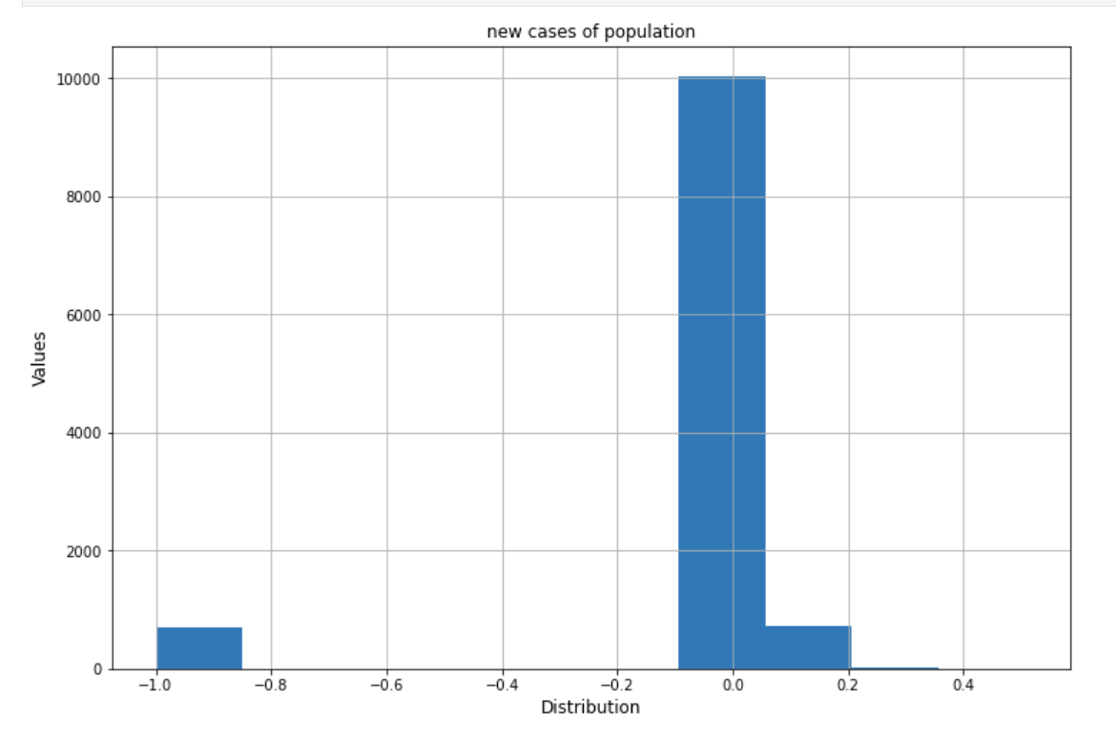
Machine Learning Part for 'new cases of population'
the histogram of 'new cases of population' column to see the distribution

Slide 15
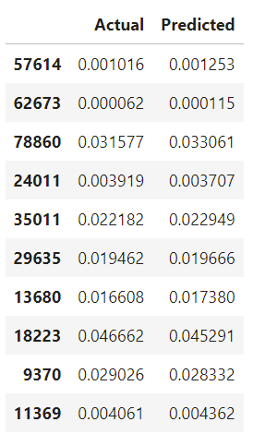
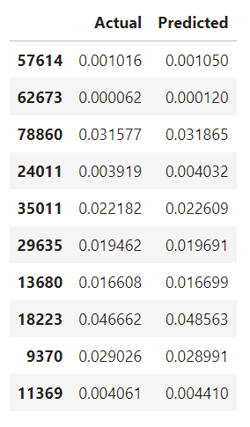
Decision Tree Regression Model
Random Regression Model

Slide 16
Conclusion
both performed well on this data set, but Random seems performing a little better than Decision Tree in terms of evaluation metrics to predict 'new cases of population' using this data set

